Slide 1
Data @ Next Big Sound

Slide 2
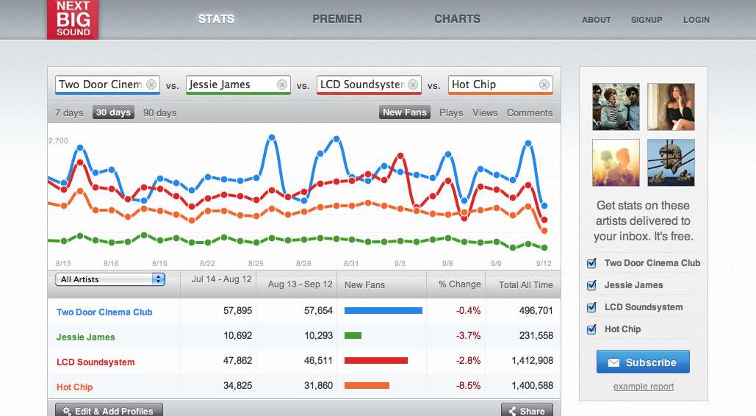
Track All the Things in Music

Slide 3
Goals of the Architecture
The usual crap:
Cost
Performance
Scalability
Disaster Recovery
Blah blah

Slide 4
Goal #1
Logical Fault Tolerance (err Data Agility?)
Data model refactors
Ever-improving entity matching
Human errors causing data “bugs”
Updates to live, production DBs
Not just us!

Slide 5
This doesn’t make sense
Think of one software/data co that doesn’t use Git/Svn/etc….
What about one that takes that same approach to the data that code creates?

Slide 6

We might look dumb in the future
Single dataset databases work well enough now but maybe there’s a better long term solution…

Slide 7
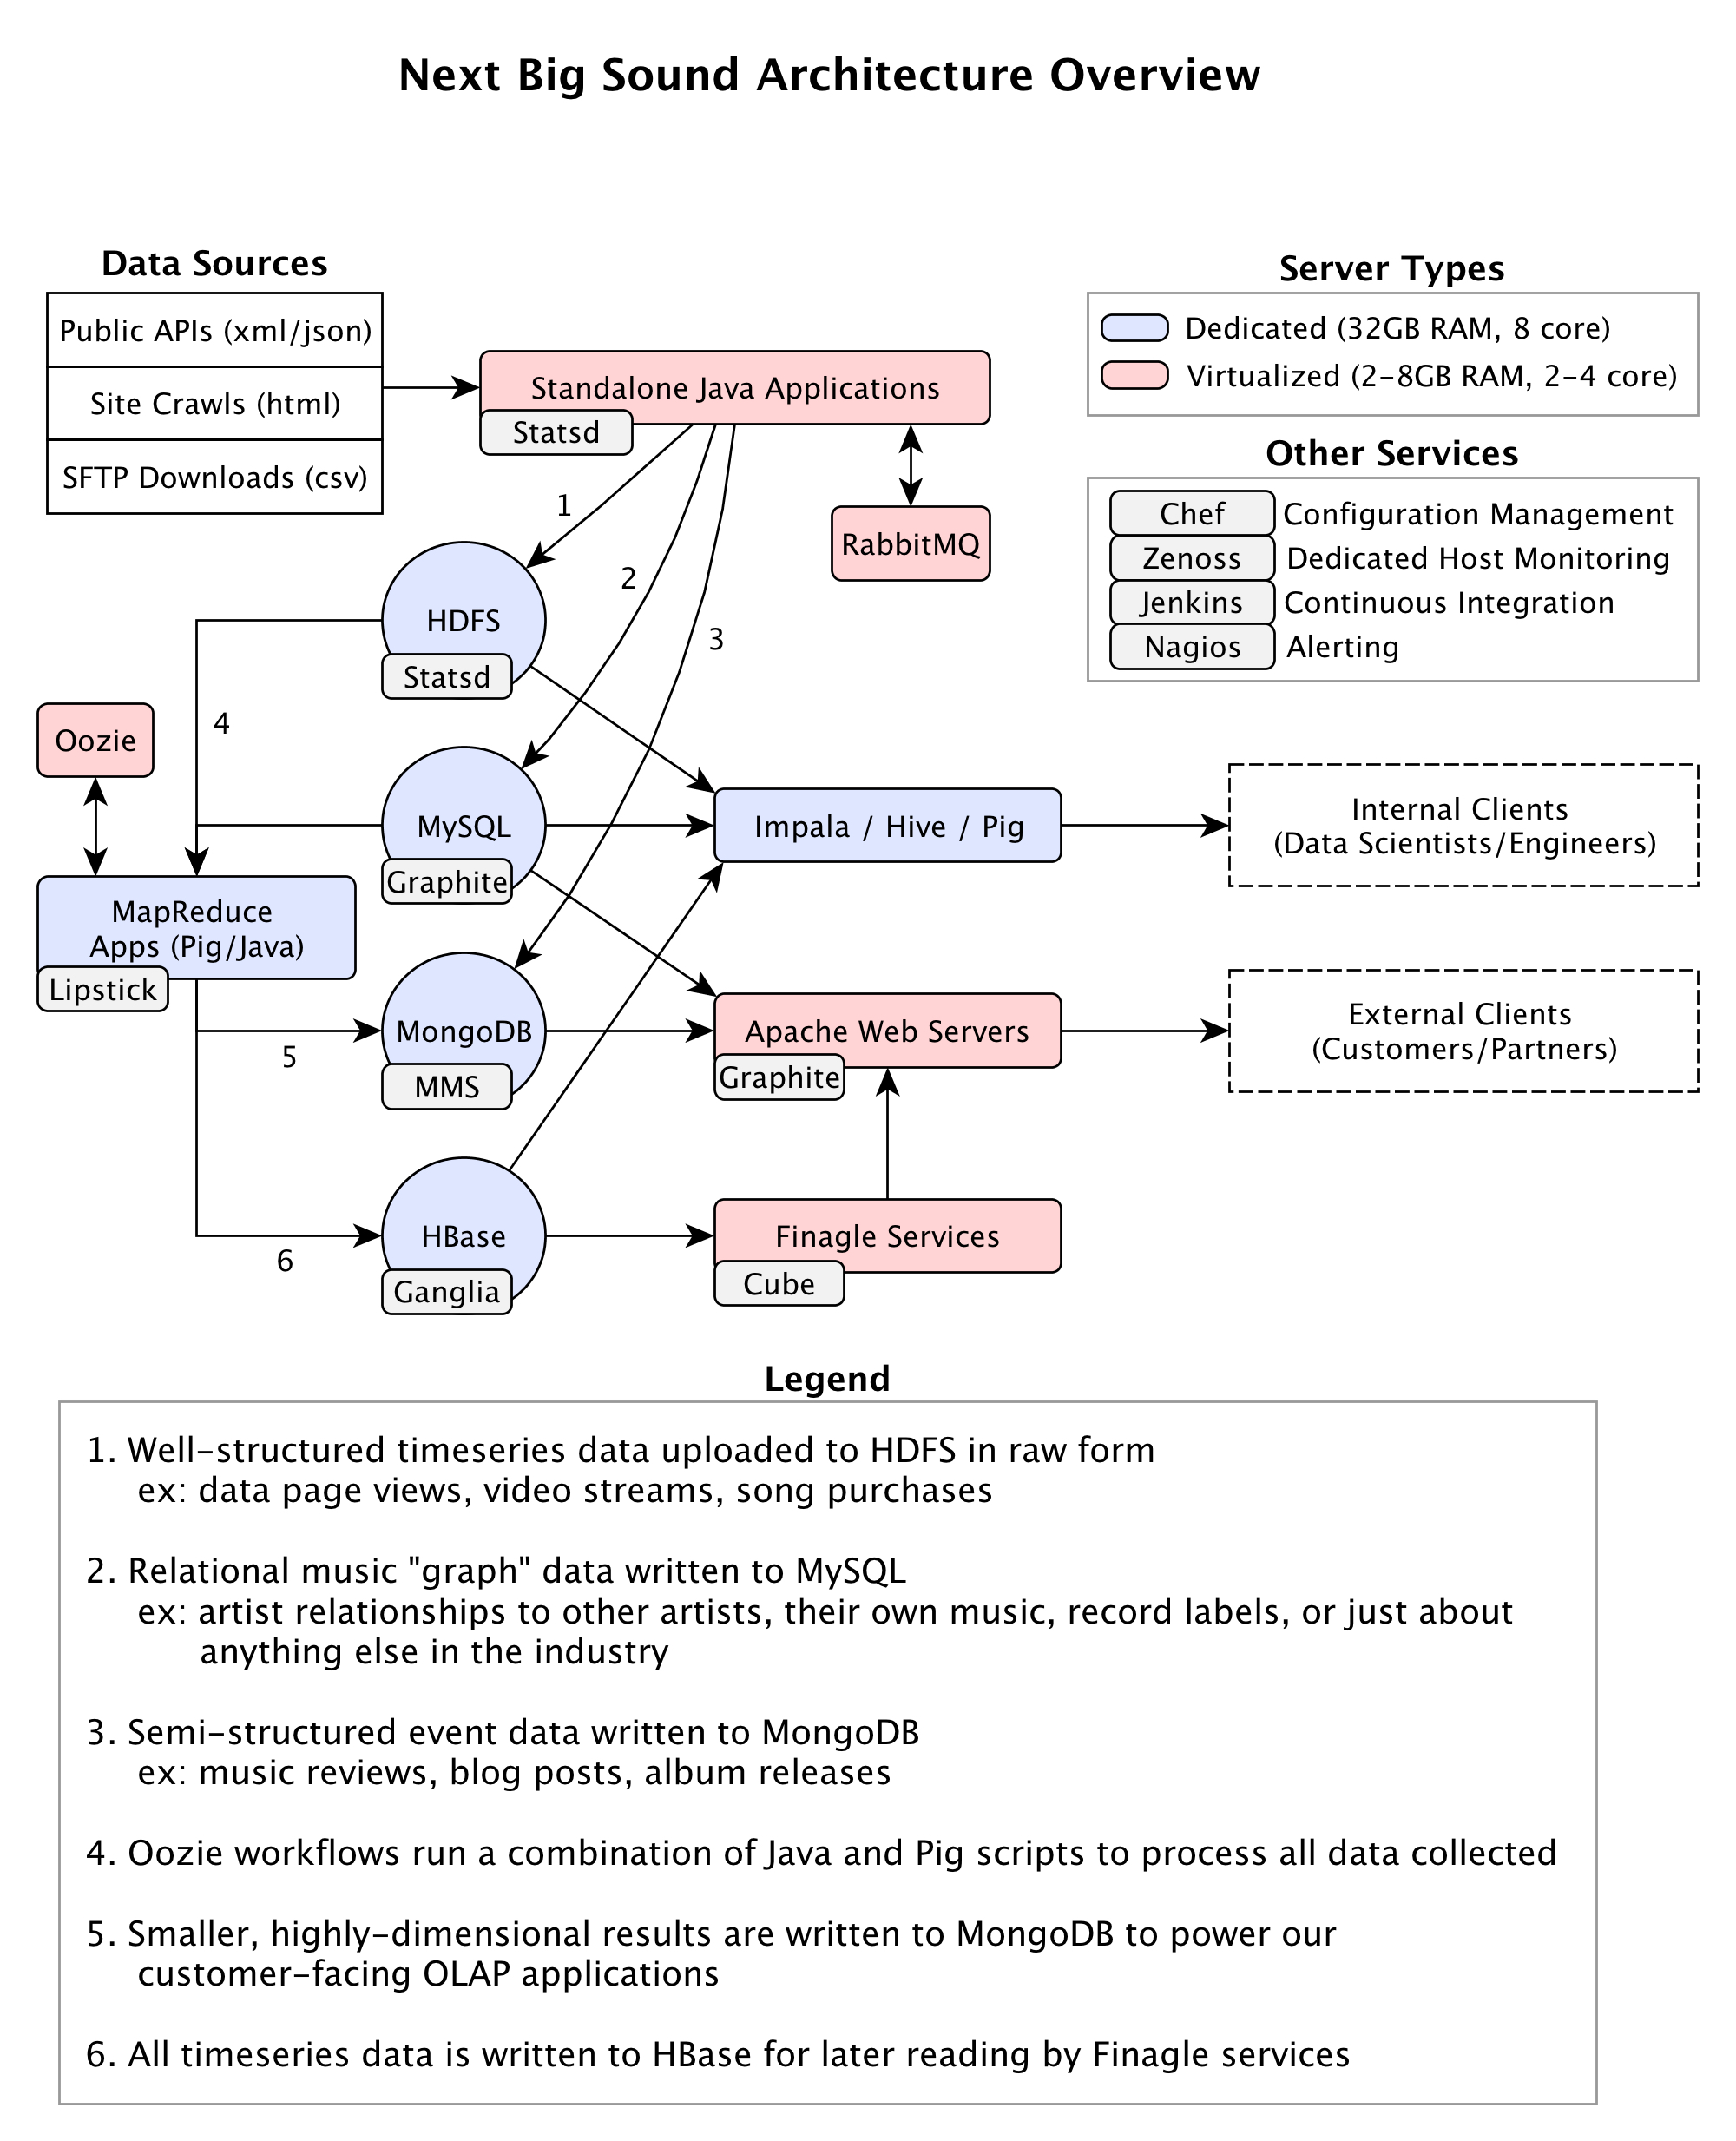
High Level Systems
https://dl.dropboxusercontent.com/u/65158725/nbs_arch.png

Slide 8
A Few Stats
40 Node Hadoop Cluster (150TB)
400G max per day ingestion
Machines - 2 x 4 core, 32 GB RAM, 4 x 1T SATA
Dell servers running Ubuntu ($3,400 / unit)
Cloudera 4.3.0

Slide 9
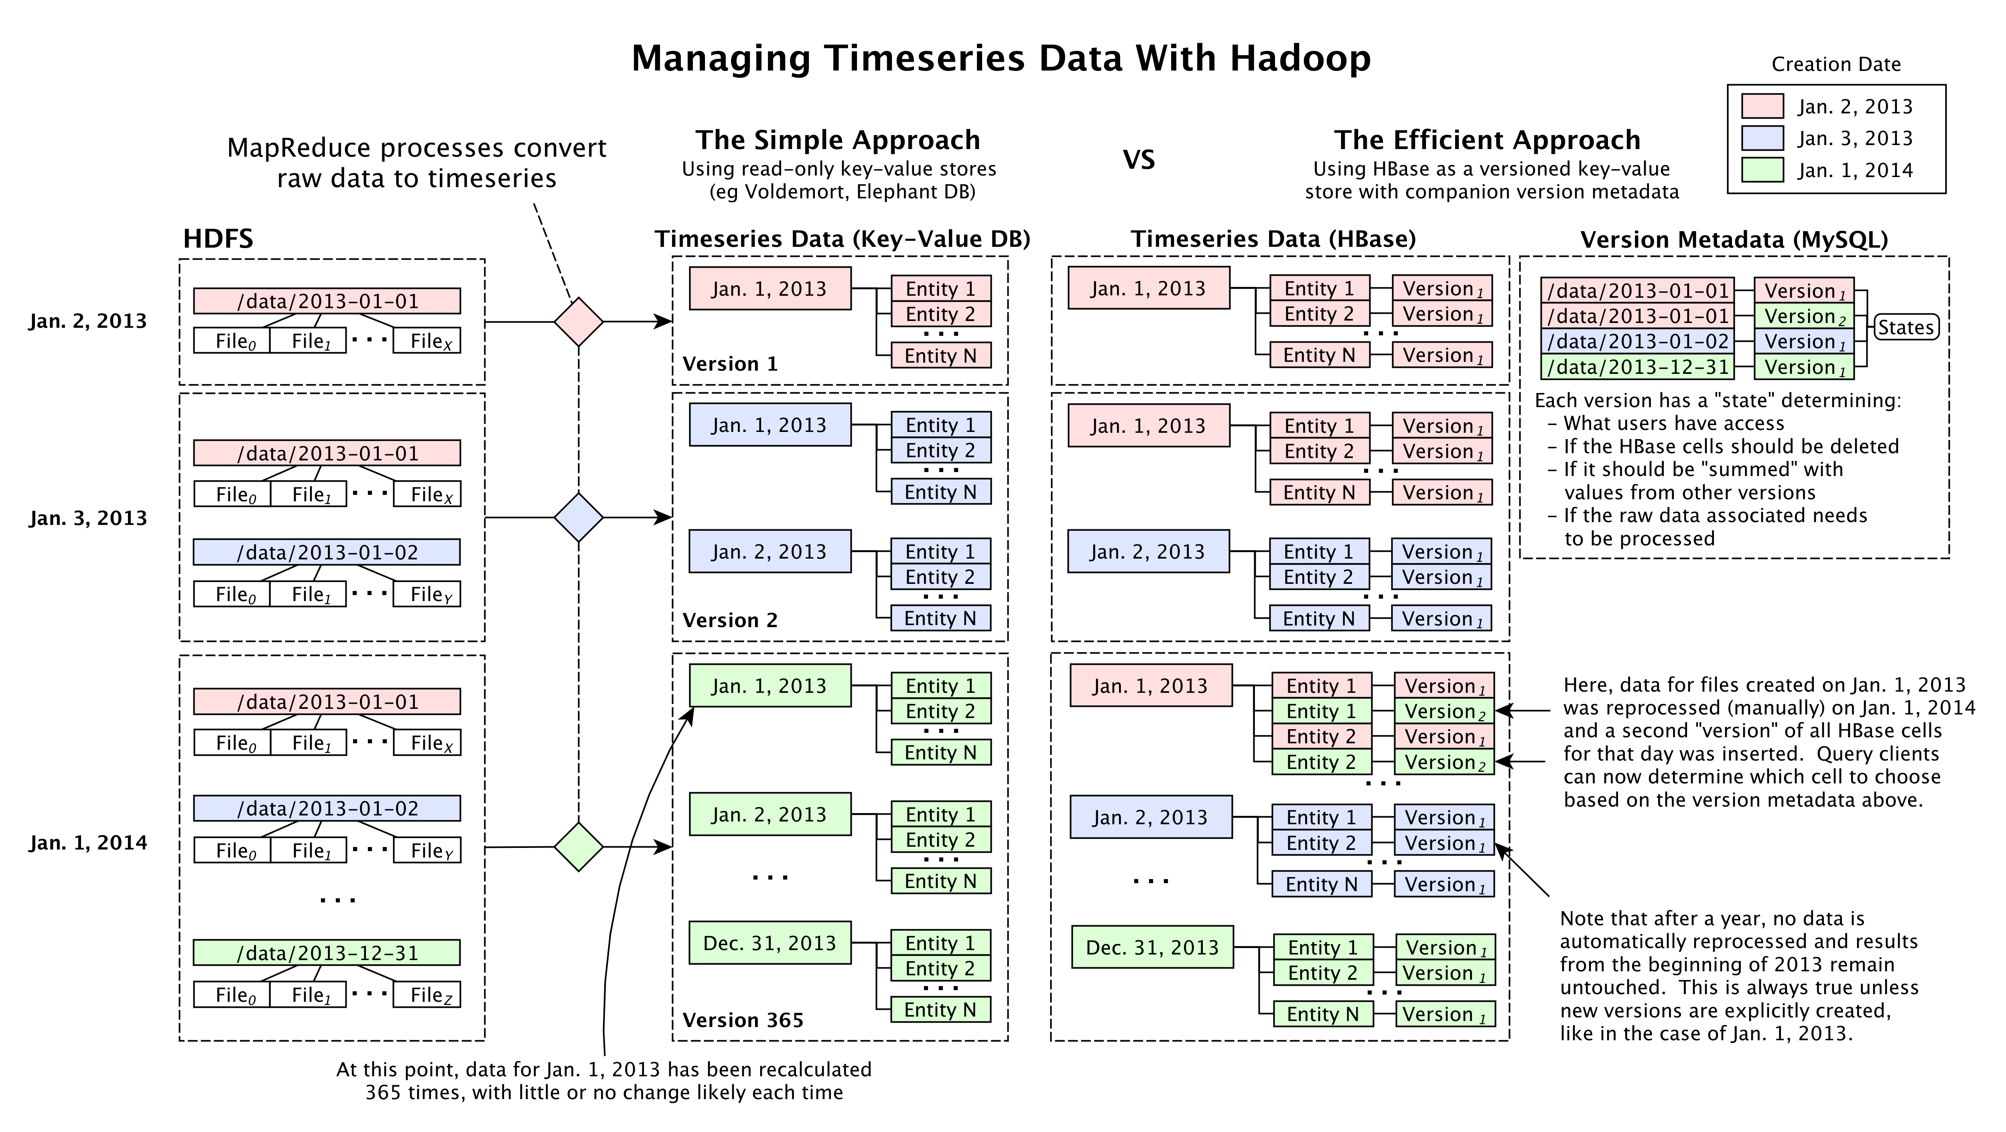
Version Control w/ HBase
https://dl.dropboxusercontent.com/u/65158725/hadoop_arch.png

Slide 10
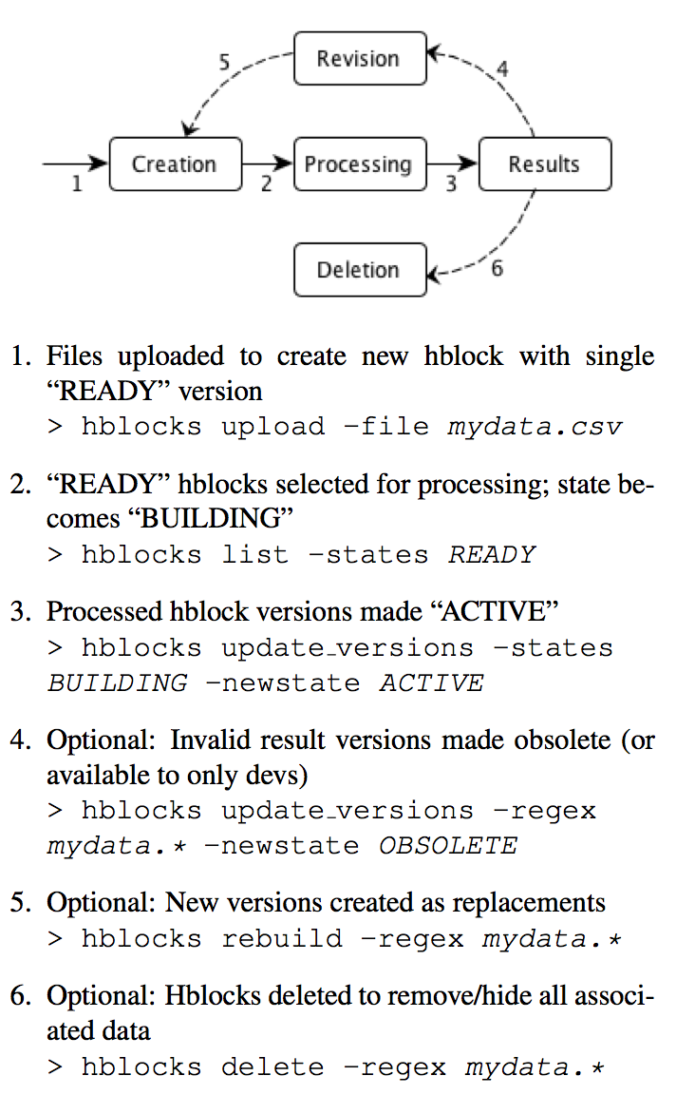
Data Versioning
/Users/eczech/Desktop/hblocks_api.png

